Slide 1
Software Testing
Chapter 4:White-box testing
Condition testing

Slide 2
White-Box Testing Techniques
Black-Box Testing Techniques
Statement coverage
Decision coverage
Condition coverage
Decision-condition coverage
Multiple-condition coverage
Equivalence partitioning
Boundary-value analysis
State-transition
Error guessing

Slide 3
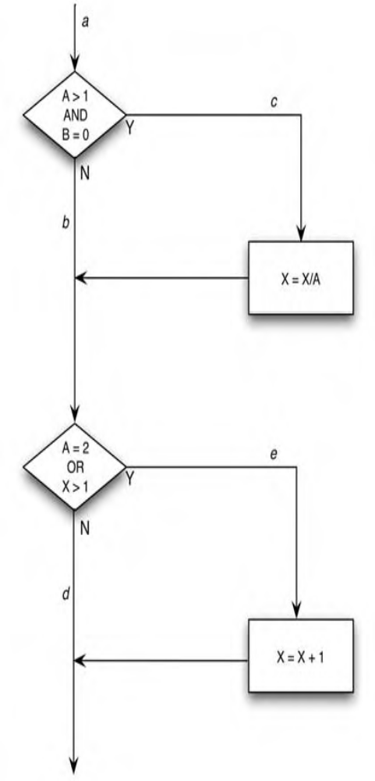
Statement Coverage
void foo(int a, int b, int x)
{
if (a>1 && b==0) {
x=x/a;
}
if (a==2 || x>1) {
x=x+1;
}
}
Figure 4.1

Slide 4
All possible Paths
Path | Input | Output
ace | A=2, B=0, X=4 | X=3
abd | A=0, B=0, X=0 | X=0
acd | A=3, B=0, X=3 | X=1
abe | A=2, B=1, X=1 | X=2
Which paths provide the
most coverage?

Slide 5
Decision Coverage or Branch Coverage
A stronger logic-coverage criterion than the statement coverage.
We must write enough test cases to cover each decision with both the true and false outcomes at least once.
In case of multiple choices in a decision, we must write test cases to cover all choices at least once
  Switch statement in C and Java

Slide 6
Decision Coverage vs. Statement coverage
So a stronger definition of the decision coverage
  The decision-coverage testing requires that each outcome of each decision is exercised at least once, that each statement is exercised at least once, and that each entry point is invoked at least once.

Slide 7
Decision Coverage
Exercise Figure 4.1
There are two sets of test cases that satisfy the criterion:
Path | Input | Output
ace (Y,Y) | A=2, B=0, X=4 | X=3
abd (N,N) | A=1, B=1, X=1 | X=1
acd(Y,N) | A=3, B=0, X=3 | X=1
abe(N,Y) | A=2, B=1, X=1 | X=2

Slide 8
Decision Coverage
Problems!
If the second decision were in error (if it should have said X<1 instead of X>1),
  the mistake would not be detected by the two test cases in Yellow.
Therefore, we need a better coverage criterion.

Slide 9
Condition Coverage
This testing requires that we write enough test cases so that each condition in each decision takes on all possible values at least once
A stronger logic-coverage test than the decision coverage

Slide 10
Condition Coverage
Exercise Figure 4.1
Four conditions
  A > 1
  B = 0 (B == 0 in C and Java)
  A = 2 (A == 2 in C and Java)
  X > 1
When we pick a value for a variable, the value may satisfy more than one condition requirements
    A B X
    2 0 4 (ace) y, y
    1 1 1 (abd) n, n

Slide 11
Condition Coverage-All decisions
Condition coverage test cases must cover yes and no for:
  A > 1, B = 0
  A = 2, X > 1
The following table covers all decisions, but how many conditions?
Path | Input | Output | A>1 | B=0 | A=2 | X>1 | Branch1 | Branch2
ace | A=2, B=0, X=4 | X=3 | T | T | T | T | T | T
abd | A=1, B=1, X=1 | X=1 | F | F | F | F | F | F
acd | A=3, B=0, X=3 | X=1 | T | T | F | F | T | F
abe | A=2, B=1, X=1 | X=2 | T | F | T | F | F | T
Again, decision coverage does not cover all conditions as shown in this example.

Slide 12
Condition Coverage-All decisions
Another set of condition-coverage test cases
    A B X path Conditions
    2 4 4 (abe) T F T T
    0 0 1 (abd) F T F F
  These test cases covers all conditions
  However, The path c and the statement on path c are never executed by this set of test cases.
  So, condition coverage does not guarantee decision coverage, thus no guarantee for path or statement coverage
  Also try
    A=1, B=0, X=3
    A=2, B=1, X=1

Slide 13
Condition Coverage (cont’d)
if A or B then
s1
else
s2
end_if_then_else
 | A | B | Branch
test 1 | T | F | true
test 2 | F | F | false

Slide 14
Condition Coverage (cont’d)
if A or B then
s1
else
s2
end_if_then_else
 | A | B | Branch
test 3 | T | F | true
test 4 | F | T | true

Slide 15
Condition Coverage (Continued)
Solution! Decision-Condition Coverage
Select test cases such that
  Every condition outcome and every decision outcome are exercised at least once.

Slide 16
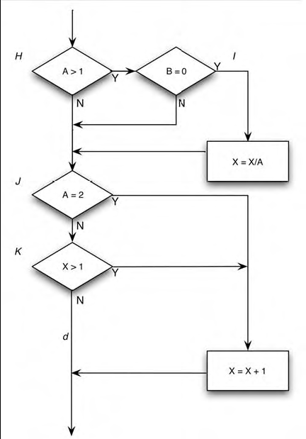
Try the in RED do they cover all decisions and conditions
Path | Input | Output
ace | A=2, B=0, X=4 | X=3
abd | A=1, B=1, X=1 | X=1
acd | A=3, B=0, X=3 | X=1
abe | A=2, B=1, X=1 | X=2
The two test cases (ace, abd) that We thought would provide condition coverage, but actually do not.
The false outcome of condition I (B==0) is missed
The true outcome of condition K (X>1) is missed

Slide 17
Multiple Condition Coverage
We write sufficient test cases so that all possible combinations of condition outcomes in each decision and all points of entry are exercised at least once
The multiple condition coverage satisfies condition-, decision-, and decision/condition-coverage criteria

Slide 18
Multiple Condition Coverage (Continued)
In Figure, we need to write test cases that cover the following outcome combinations:
A> 1 and B=0
A > 1 and B<>0
A<=1 and B=0
A<=1 and B<>0
A=2 and X>1
A=2 and X<=1
A<>2 and X>1
A<>2 and X<=1

Slide 19
Multiple Condition Coverage (Continued)
The following test cases cover all eight possibilities:
    A=2, B=0, X=4 Covers 1, 5
    A=2, B=1, X=1 Covers 2, 6
    A=1, B=0, X=2 Covers 3, 7
    A=1, B=1, X=1 Covers 4, 8
  Multiple-condition coverage does not guarantee path coverage
    The above test cases miss path acd
  The fact that there are four test cases and four paths in the program is a pure coincidence.
  There is no relationship between the number of paths and the number of test cases

Slide 20
Multiple Condition Coverage Examples
if(A && B) // condition 1
F1();
else
F2();
if(C || D)// condition 2
F3()
else
F4();
Test Cases for MCC:
For condition 1 For condition 2
A=T, B=T C=T, D=T
A=T, B=F C=T, D=F
A=F, B=T C=F, D=T
A=F, B=F C=F, D=F

Slide 21
Path Coverage
This measure reports whether each of the possible paths in each function have been followed.
A path is a unique sequence of branches from the function entry to the exit.
Since loops introduce an unbounded number of paths, this measure considers only a limited number of looping possibilities.

Slide 22
Path Coverage Examples
A
if (A)
F1();
F2();
if (A)
F3();
F4();
Paths:
A-F1-F2-A-F3-F4
A-F2-A-F3-F4
A-F1-F2-A-F4
A-F2-A-F4
Problem: two only
are feasible
A=T
A=F
F1
F2
A
F3
F4

Slide 23
Path Coverage Comments
Path coverage has the advantage of requiring very thorough testing.
Path coverage has two severe disadvantages.
  The first is that the number of paths is exponential to the number of branches.
  The second disadvantage is that many paths are impossible to exercise due to relationships of data.

Slide 24
Loop Coverage
This measure reports whether each loop body in the program has been executed zero times, exactly once, and more than once (consecutively).
For do-while loops, loop coverage reports whether the body has been executed exactly once, and more than once.
The valuable aspect of this measure is determining whether while-loops and for-loops execute more than once, information not reported by others measure [1].

